Slide 1



PROJECT ON
Shopsy Television pricing Analysis
Presented By:
Name : Y.JYOTHI
Batch : 456

Slide 2

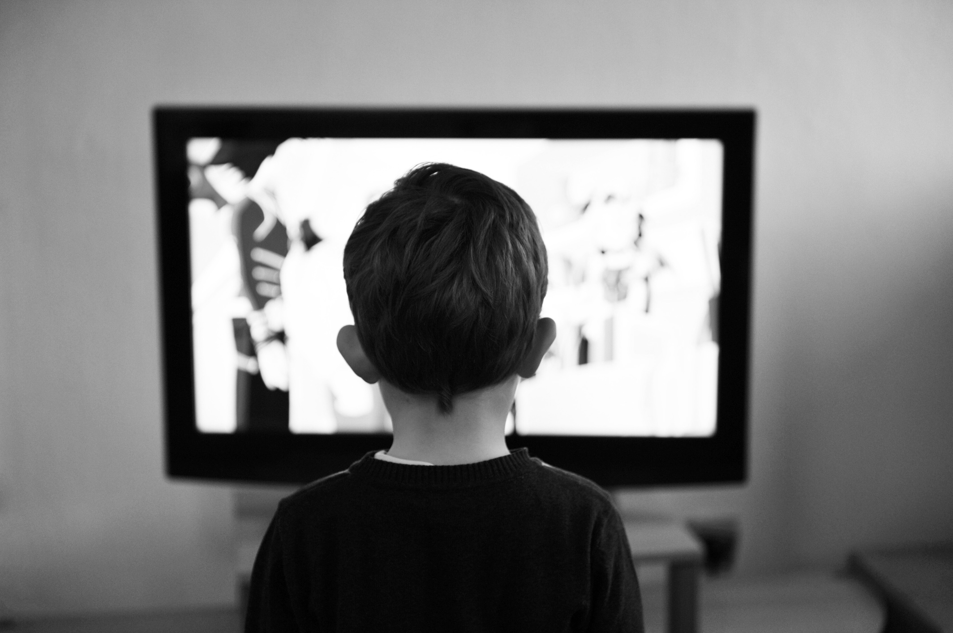


AGENDA
Introduction and Domain Overview
Business Problem and Objectives
Data Source and Web Scraping (Shopsy)
Dataset Overview and Data Cleaning
Exploratory Data Analysis (EDA)
Univariate Analysis
Bivariate Analysis
Multivariate Analysis
Key Insights and Business Findings
Conclusion and Recommendations

Slide 3
Domain Understanding
This project belongs to the E-commerce and Retail Analytics domain, focusing on television products sold on the Shopsy platform.
The dataset includes:
Television brands
Prices and discounts
Screen sizes and resolutions
Display panel types
Operating systems
Customer ratings

Slide 4

Business Problem
Jyothi, a consumer planning to purchase a television online from Shopsy, observes that TVs with similar specifications have widely different prices.
For example:
One TV costs around ₹12,000
Another similar TV costs ₹60,000+
Screen sizes vary from 32 inches to 55+ inches
4K TVs are priced much higher than HD Ready TVs
Premium operating systems increase TV prices
Discounts differ greatly even for similar models
This creates confusion for consumers while choosing the right TV.

Slide 5

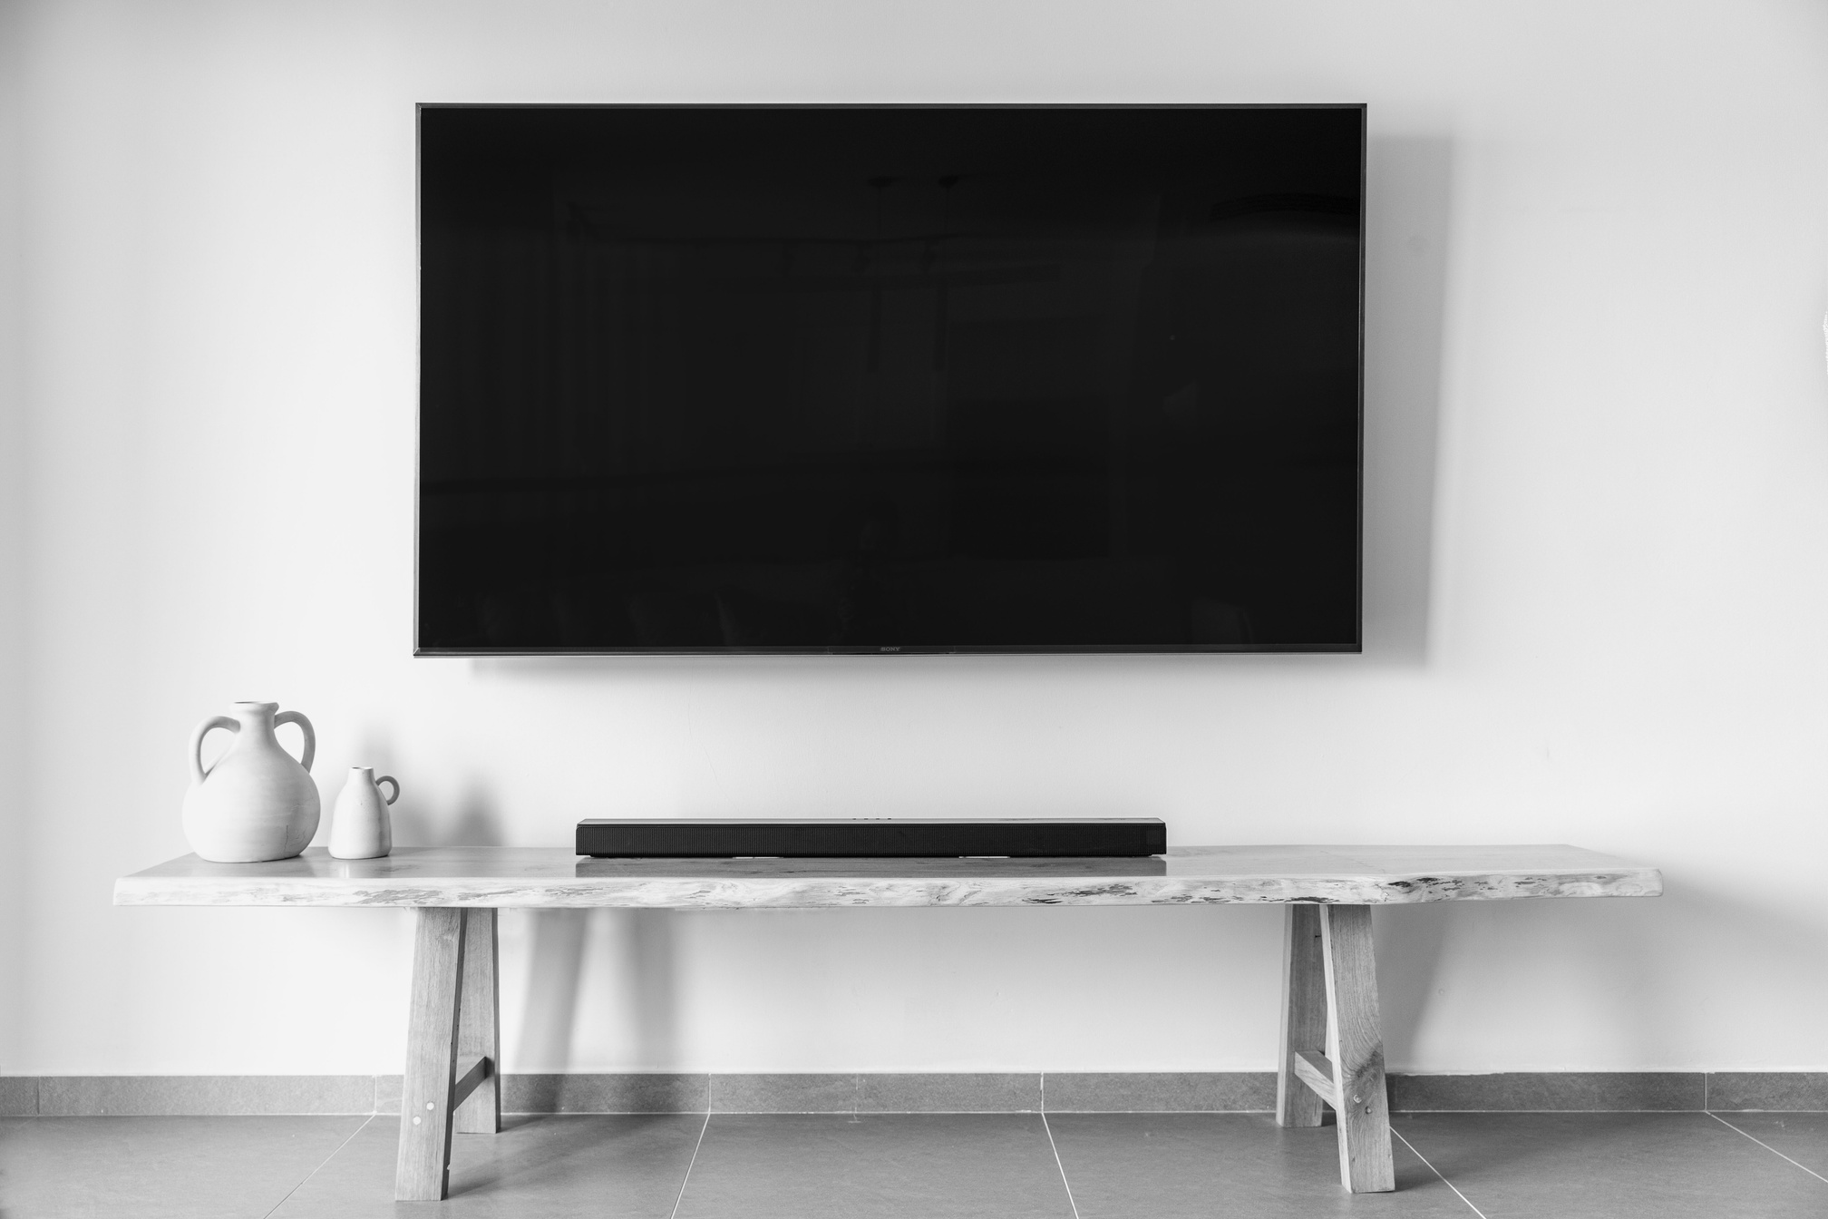
Business Problem Statement
Television pricing on Shopsy varies significantly due to:
Brand positioning
Screen size
Resolution
Display panel technology
Operating system
Discount strategies
This variation makes it difficult for consumers to:
Understand pricing logic
Identify value-for-money TVs
Compare products effectively
To address this, Exploratory Data Analysis (EDA) is used to uncover hidden pricing patterns.

Slide 6

Objectives of the Project
Analyze TV prices across different brands on Shopsy
Study the impact of screen size on price
Compare pricing across resolutions (HD Ready, Full HD, 4K)
Evaluate the effect of display panel type on pricing
Analyze the influence of operating systems
Identify TVs that offer the best value for money

Slide 7
Data Source & Collection
Website: Shopsy (Television category)
Data Type: Publicly available product listings
Method: Web Scraping
Tools Used:
Python
Requests
Selenium
Pandas
Ethical scraping practices were followed by accessing only publicly available data.

Slide 8
Process Followed:
Identified Shopsy television listing pages and relevant product URLs.
Sent HTTP requests to fetch HTML content of product pages.
Parsed HTML using Selenium to extract attributes such as brand, price, screen size, resolution, ratings, and discounts.
Cleaned and structured the extracted data into tabular format using Pandas.
Exported the final dataset to an Excel/CSV file for further analysis.

Slide 9
Dataset Overview
Rows: TV product listings from Shopsy
Columns include:
1. Brand
2. Original Price and Discount Price
3. Screen Size
4. Resolution: The number of pixels displayed on the screen, determining,
image clarity and sharpness.
5. Panel Type: The display technology used in the TV screen that affects
picture quality and viewing angles.
6. Operating System: The software platform that runs the Smart TV and
support apps and smart features.
7. Ratings
Data Type: Numerical + Categorical

Slide 10
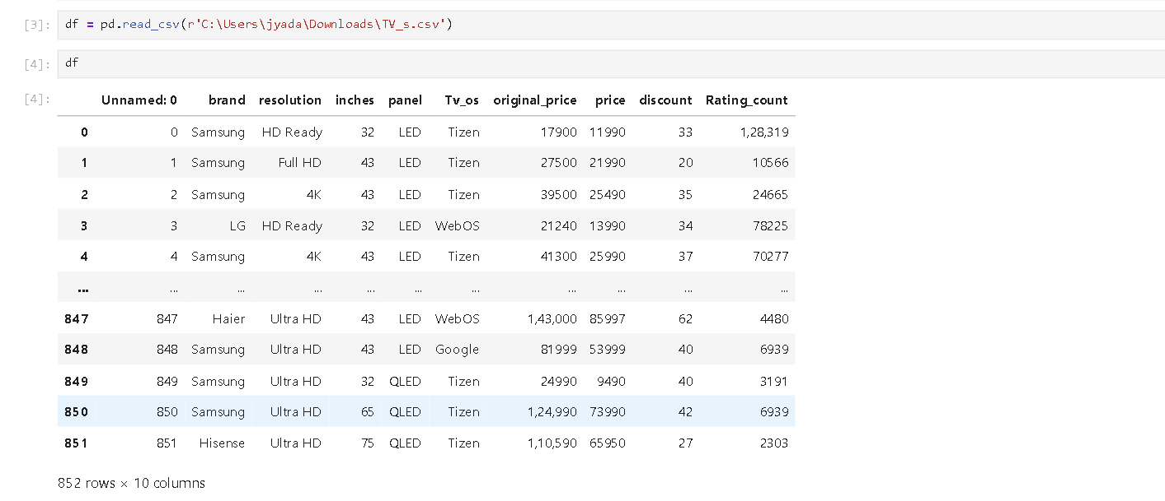
Reading Dataset

Slide 11
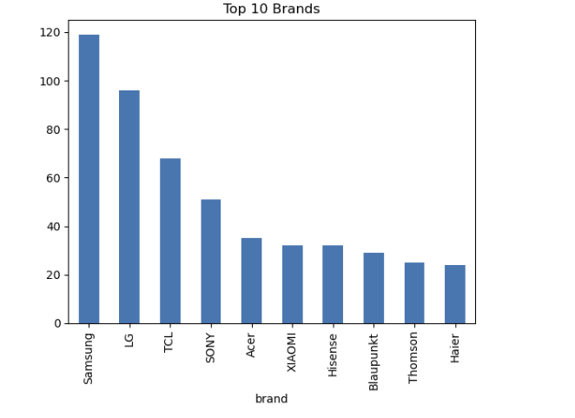
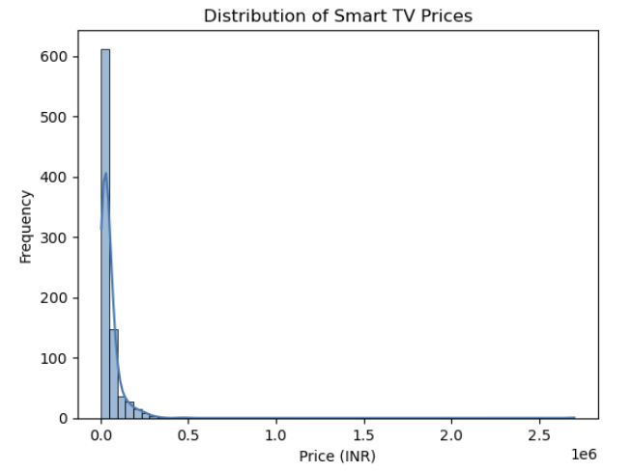
Univariate Analysis
Smart TV prices are highly right-skewed, with most products clustered in the low to mid-price range.
Very few high-priced TVs exist, indicating premium models are limited and mainly serve niche or brand positioning purposes.

Slide 12
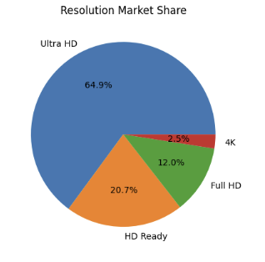
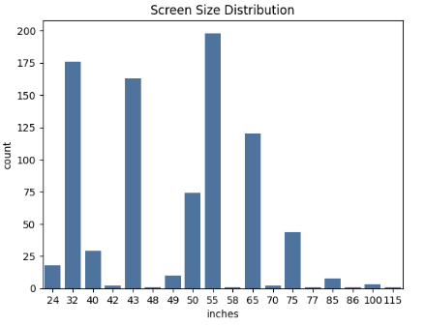
Ultra HD TVs dominate the market, accounting for nearly two-thirds of all available models. HD Ready TVs still maintain a notable presence, while Full HD occupies a smaller share.
The relatively low proportion of 4K-labeled models suggests that Ultra HD has become the standard resolution category, with other resolutions gradually losing relevance in the Smart TV market.
Smart TV demand is highest for mid-sized screens (43–55 inches), showing a strong preference for home-usable, value-for-money models.
Very large screen sizes (above 70 inches) have low counts, indicating they cater to a niche, premium customer segment rather than mass adoption.

Slide 13
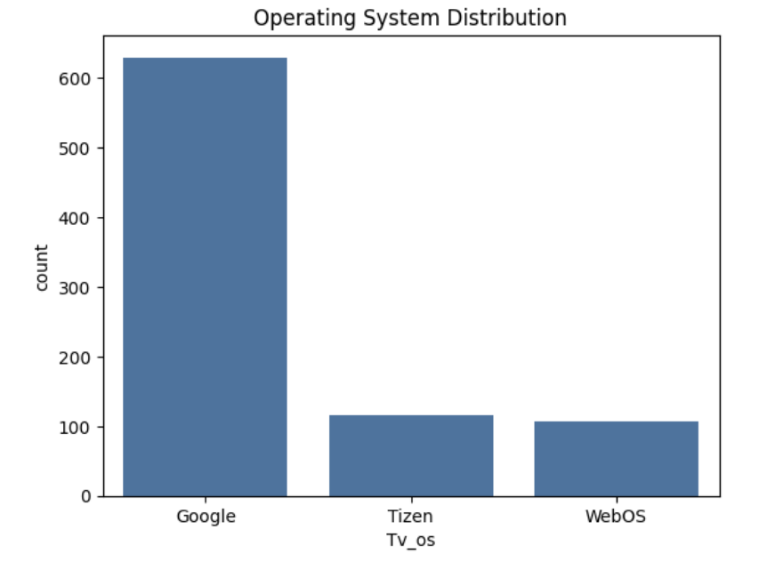
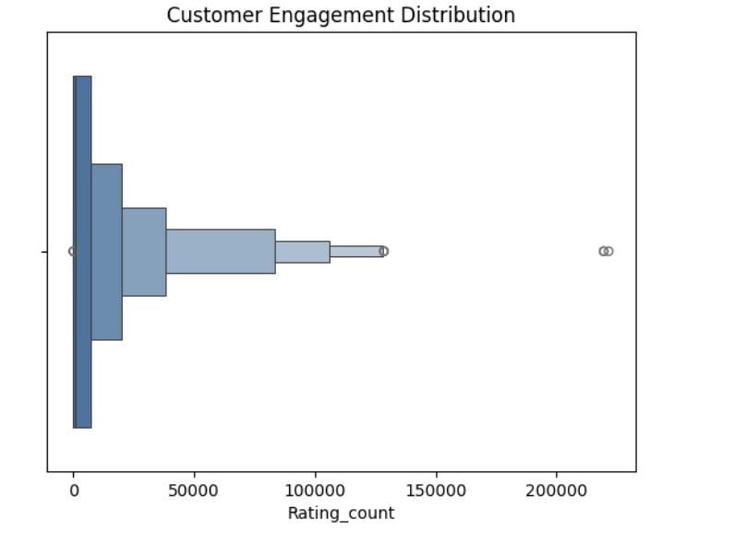
Customer engagement is highly right-skewed, with most Smart TVs receiving low ratings while only a few models dominate user attention.
Google TV overwhelmingly dominates the market, far exceeding other operating systems like Tizen and WebOS.

Slide 14
Univariate Analysis
Univariate analysis helped me understand individual variable distributions.
Most TVs fall in the mid-price range, prices are right-skewed, and mid-sized screens like 43–55 inches dominate the market.”

Slide 15
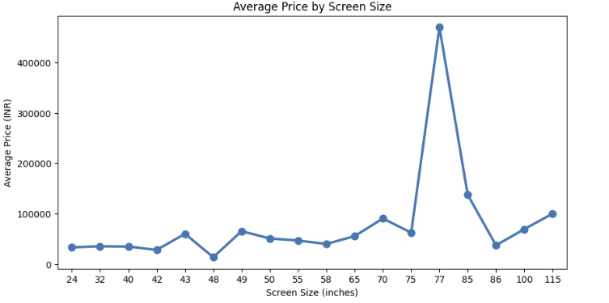
Average TV price generally increases with screen size, showing a positive size–price relationship.
Mid-size TVs (40–55 inches) are relatively stable and affordable compared to very large screens.
Large screens (75–85 inches) show sharp price jumps, indicating premium pricing.
A few extreme spikes (outliers) suggest high-end or luxury TV models at certain sizes.
Price variation increases as screen size grows, meaning larger TVs have wider price ranges.
BIVARIATE

Slide 16
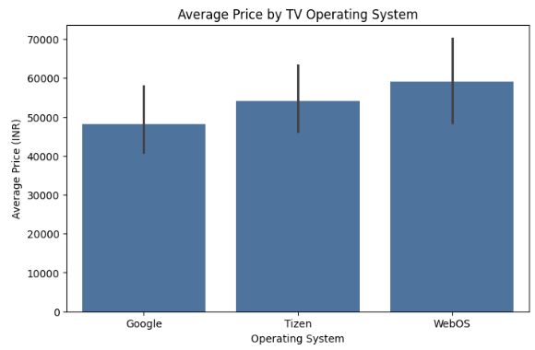
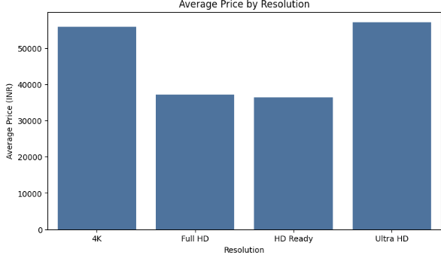
TV prices increase with resolution, with 4K (Ultra HD) models showing a clear premium over HD Ready and Full HD TVs.
WebOS-based TVs are priced highest on average, while Tizen occupies the mid-range and Google TV targets budget-conscious buyers.
Overall, higher resolution and premium operating systems together drive increased pricing and wider price variability.

Slide 17
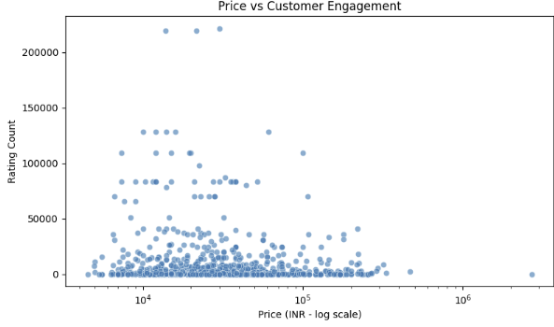
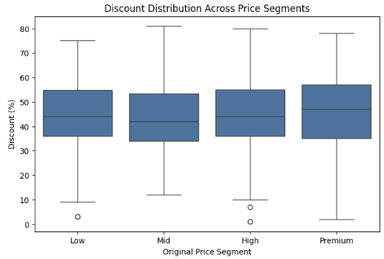
The median discount percentage increases slightly as we move from low-priced to premium-priced TVs.
Premium segment TVs show a wider discount range, indicating more aggressive and flexible discounting strategies.
This suggests that higher original prices are often paired with larger advertised discounts, likely used as a psychological pricing tactic rather than reflecting proportional cost savings.
Customer engagement is strongest in the ₹10,000–₹50,000 price range, highlighting high interest in affordable TVs
. Higher prices do not guarantee greater engagement, as many expensive models receive fewer ratings.
Overall, perceived value and affordability drive customer interaction more than premium pricing.

Slide 18
Bivariate Analysis
In bivariate analysis, I studied relationships between price and other variables.
I observed that price increases with screen size and resolution, and premium operating systems like WebOS increase average price.”

Slide 19
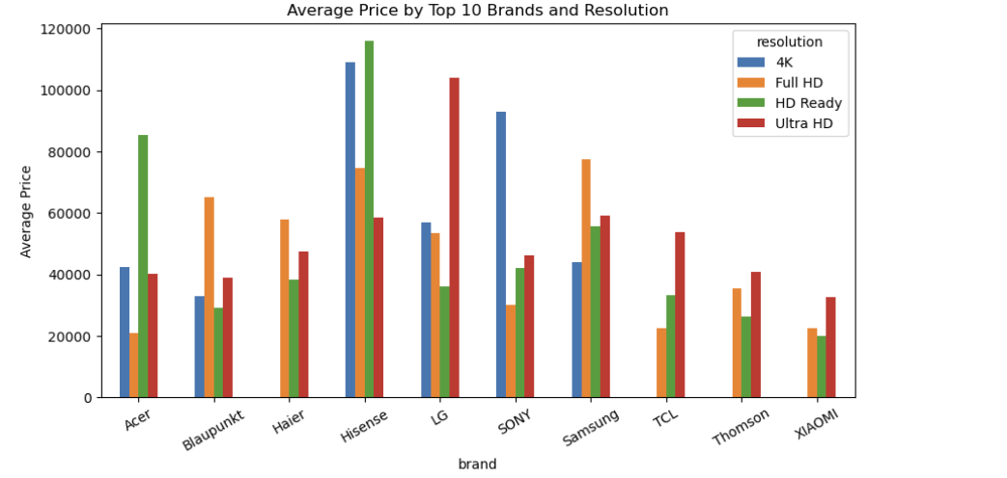
Multivariate Analysis
“This multivariate plot shows how brand and resolution together impact price.
Premium brands like Sony and LG price their 4K TVs higher, while brands like Xiaomi and TCL focus on affordability.
This confirms that brand positioning plays a strong role in pricing.”

Slide 20
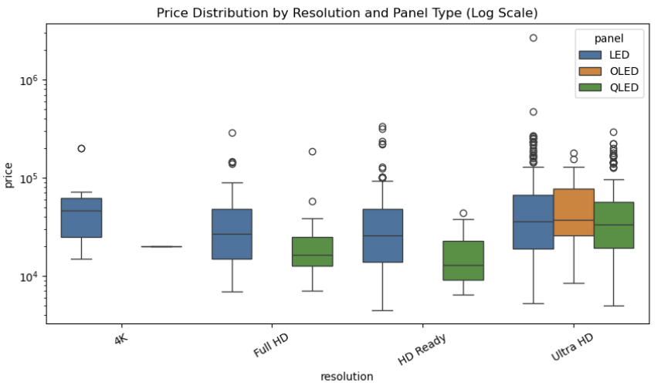
This plot shows that OLED and QLED TVs are priced significantly higher than LED TVs, especially in 4K resolution.
This indicates that advanced panel technology adds a premium beyond resolution alone.

Slide 21
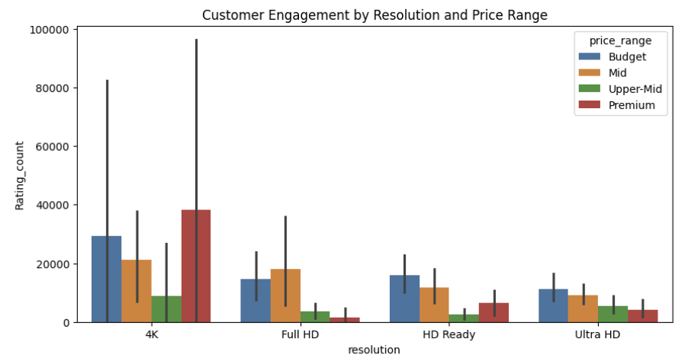
4K TVs receive the highest customer engagement, especially in the Budget and Premium price ranges, showing strong demand at both ends.
Full HD engagement is strongest in the Mid price range, indicating value-seeking customers prefer this segment.
Ultra HD and HD Ready show lower overall engagement, suggesting limited demand compared to 4K models.

Slide 22
Multivariate Analysis
Multivariate analysis shows that pricing is influenced by a combination of brand, resolution, screen size, and panel type.
Premium brands combine 4K resolution, large screens, and OLED/QLED panels, while budget brands focus on affordability.”

Slide 23
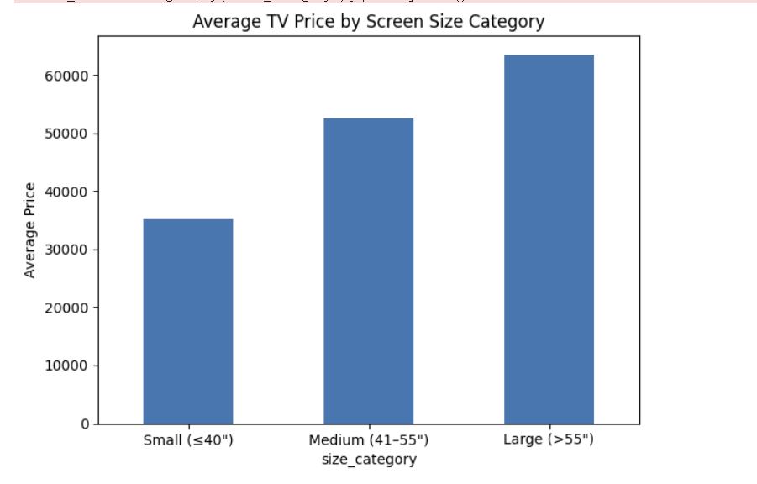
HYPOTHESIS TEST
Average TV price increases with screen size.
Large TVs (>55") are priced significantly higher than small and medium TVs.
Visual trends suggest screen size influences pricing.
One-way ANOVA confirms a statistically significant difference in mean prices across size categories.
Screen size is a key determinant of TV pricing.

Slide 24
Key Insights
Customer engagement (rating count) is highly right-skewed, with only a few Smart TV models capturing most user attention, indicating a winner-takes-most market.
Engagement is highest in the ₹10,000–₹50,000 price range, showing that affordability and value perception drive customer interaction more than premium pricing.
TV prices increase clearly with resolution, with 4K (Ultra HD) TVs priced significantly higher than HD Ready and Full HD models.
Operating system strongly impacts pricing: WebOS TVs are the most expensive, Tizen occupies the mid-range, and Google TV targets budget-conscious buyers.
Google TV dominates model availability, reflecting strong manufacturer adoption and platform standardization in the Smart TV market.

Slide 25
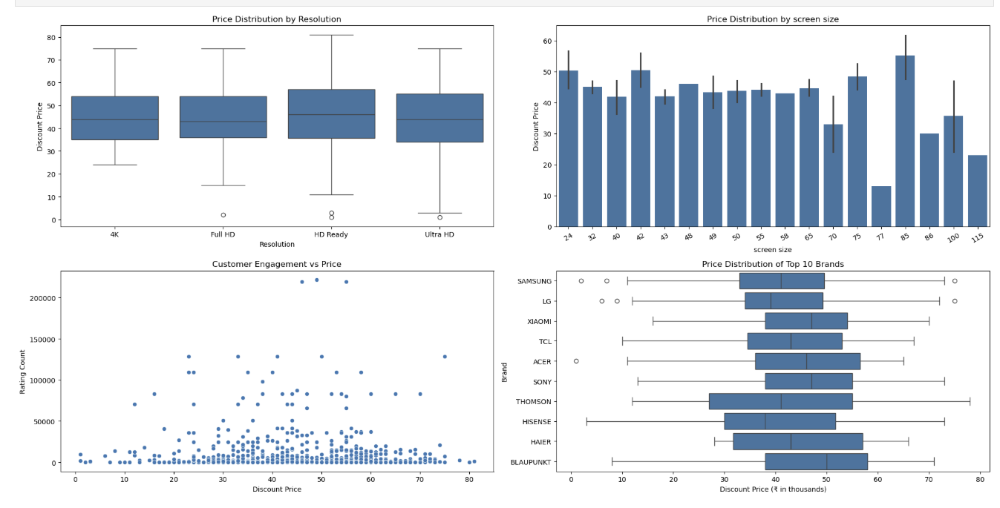
summary

Slide 26
Conclusion
Smart TV pricing depends on resolution, OS, brand, and features.
Mid-priced TVs (₹10k–₹50k) show the highest customer engagement.
Premium features raise prices but don’t always increase satisfaction.
Google TV dominates as the preferred operating system.
Affordability and value matter more than premium pricing.

Slide 27




THANK YOU !

